Slide 1
超越学科界限的认知基础
叙事结构 （Story Telling): 箭头, 类比/比喻, 反差机制, 与故事或神话的本质 第四周
顾学雍
十月六日
二零二一年

Slide 2

何谓单子？
https://en.wikipedia.org/wiki/Monad_(philosophy)
Notes:
Whats also refers to Data.

Slide 3
故事的精彩程度取决于
1. 寫作；作曲［不可數名詞。通常不與a/an/one連用, 無複數, 後接單數動詞, 用little/much等修飾。］▸ The composition of the report took two months.寫這份報告花了兩個月時間。
2. 作品；作文；(大型) 樂曲［可數名詞。可以用a/an/one修飾, 亦可加-(e)s構成複數, 用few/many等修飾。］▸ There are many spelling mistakes in your compositions.你的作文有許多拼寫錯誤。
3. 構成；構圖；成分
［可數名詞。可以用a/an/one修飾, 亦可加-(e)s構成複數, 用few/many等修飾。］
［不可數名詞。通常不與a/an/one連用, 無複數, 後接單數動詞, 用little/much等修飾。］
▸ We examined the rock to find out its composition.
我們檢驗了這一石塊，想弄清它的構成成分。
（单子的反差对应）
复合构图
Composition:
Notes:
Whats also refers to Data.

Slide 4

A Metaphor in Networked Documents
See Lo and Behold, the interview with Ted Nelson, Creator of Xanadu

Slide 5
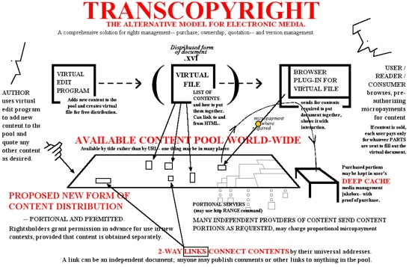
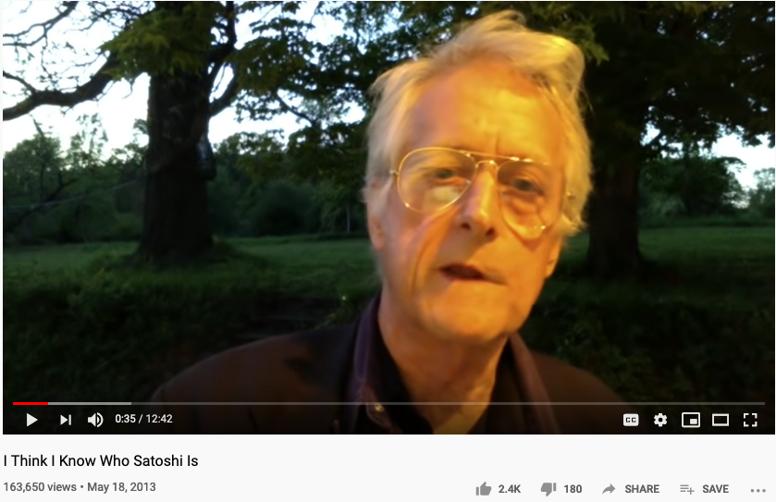
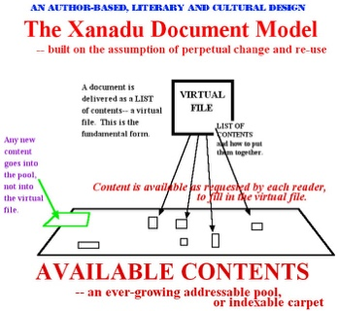
The Grand Daddy of Hypertext
Nelsdon thinks Nakamoto is: Shinichi Mochizuki
Ted Nelson in 2013:
https://youtu.be/emDJTGTrEm0?t=474
Ted Nelson’s Hypertext

Slide 6
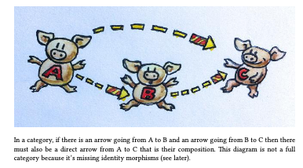
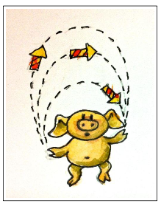
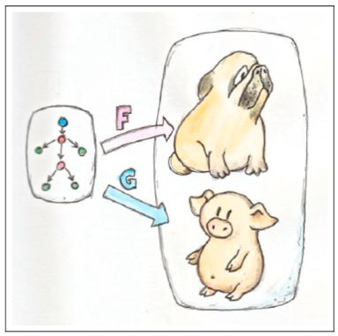
The Types of Arrows
If it looks like a pig, walks like a pig, and taste like a pig, it is a pig.

Slide 7
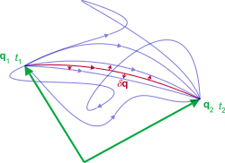
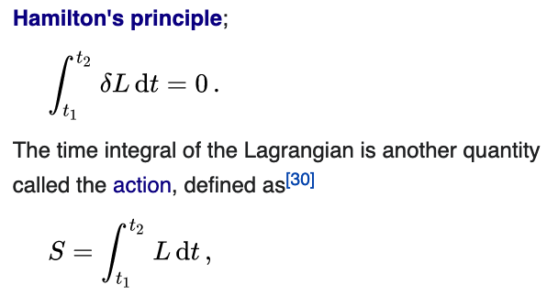
Representation of Action
Namespaces: labeled objects
Computations: transformative actions on the named objects
Action is a mathematical functional which takes the trajectory, also called path or history, of the system as its argument and has a real number as its result. Generally, the action takes different values for different paths.^{[1]} Action has dimensions of [energy]⋅[time] or [momentum]⋅[length], and its SI unit is joule-second. Action is only of interest when the total energy of the system is conserved.^{[2].}
- Wikipedia: Action
As the system evolves, q traces a path through configuration space (only some are shown). The path taken by the system (red) has a stationary action (δS = 0) under small changes in the configuration of the system (δq).^{[1]}
Source of Image and Text: Wikipedia on Hamilton’s Principle
Source of Image and Text: Wikipedia on Lagrangian Mechanics

Slide 8
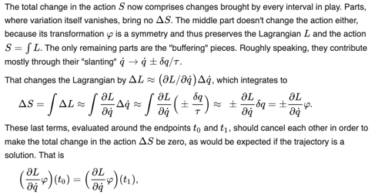
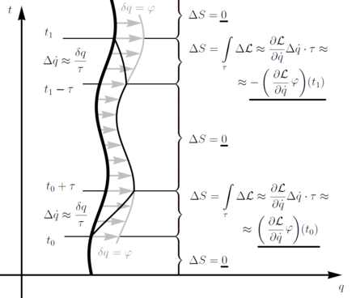
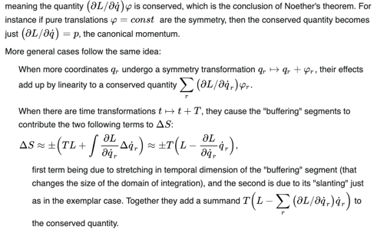
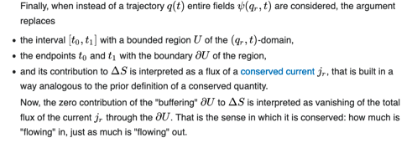
Change in Action S across multiple intervals
Source of Image and Text: Wikipedia on Noether’s Theorem

Slide 9


Category Theory can generate concrete solutions
NKS 2004, MIT A New Kind of Language for Complex Engineering Systems
Case Study: NASA’s Apollo Program Benjamin Koo
Edward F. Crawley
Represents Technologically Feasible trajectories to the moon

Slide 10
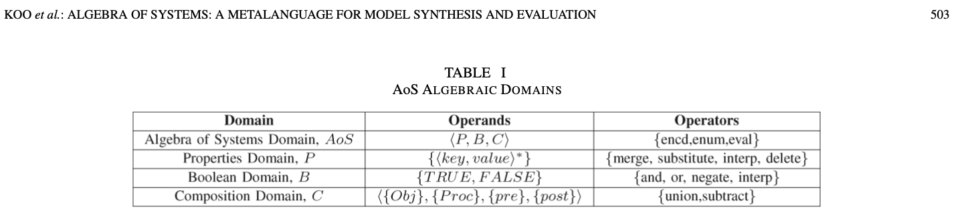
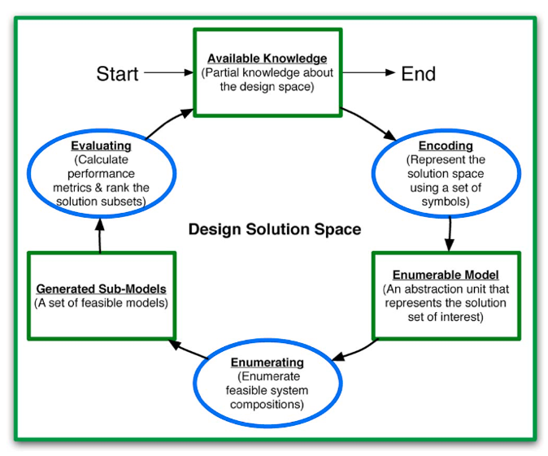
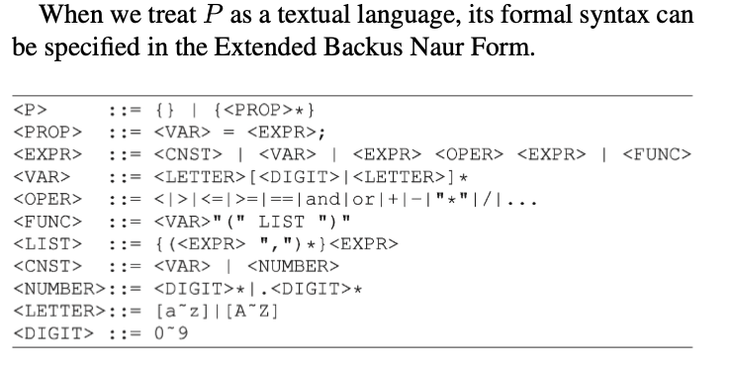
Computable Multi-level Abstractions

Slide 11
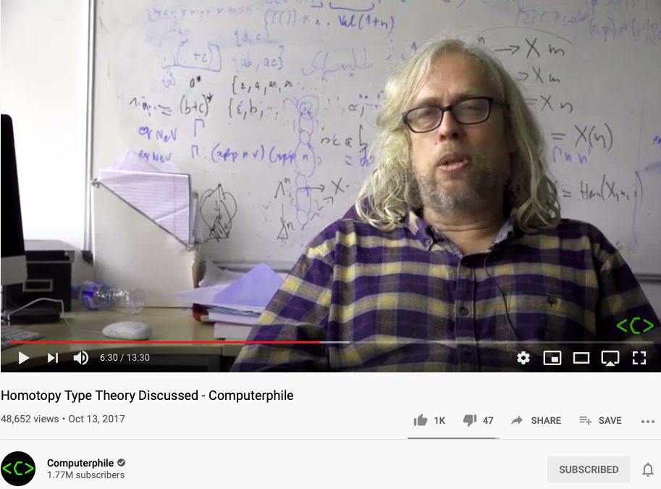
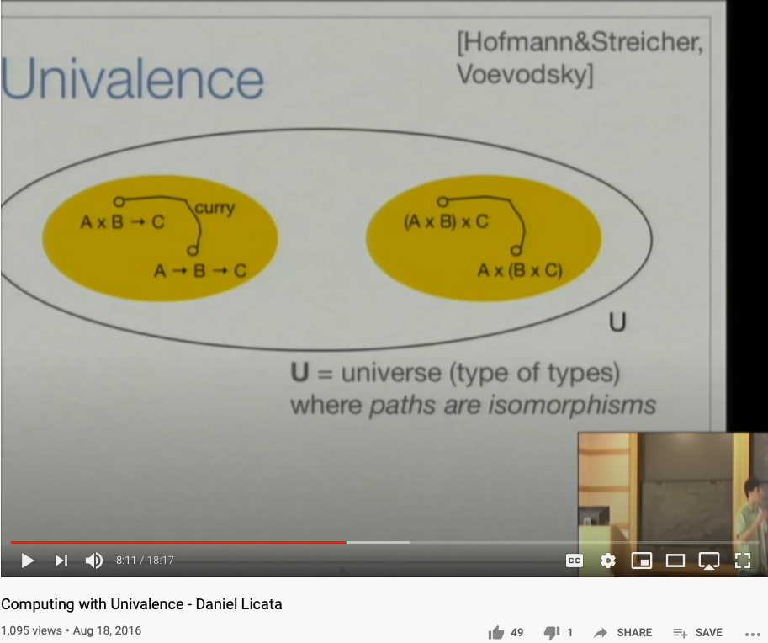
Representing Functions as Paths
Video Link: https://youtu.be/Ft8R3-kPDdk?t=390
Video Link: https://youtu.be/YDdDuq2AGw4

Slide 12



Metaphors and Story Telling

Slide 13
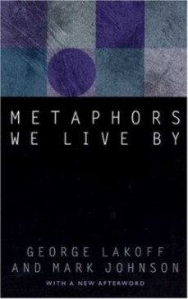

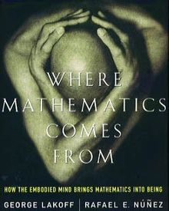
Metaphors/Analogies as a Cognitive Foundation

Slide 14


Category Theory is a way to formally represent “Analogies”
Let’s see the example :
Functor
Category
Natural Transformation
Source : Milewski, 2015

Slide 15
角色设定
选择角色
互补的叙事任务
信息压缩的效果
Think about eigen values and eigen matrices
通过命名加强人物、机构、地名的功能性设定
选择名称是否有通用的范式？

Slide 16


















三种箭头
1.函数 (Function)
$$A \underset{→}{ f } B$$
$$A$$
Object / Set $A$
Category $S$
比较/联系两个（角色）对象
2.函子 (Functor)
$$S$$
$$\underset{→}{ F }$$
$$T$$
$$A \underset{→}{ f } B$$
$$C \underset{→}{ g } D$$
比较两个系统的结构
$$S \underset{→}{ F } T$$
Functor $F$
$$F$$
3.自然转换 (Natural Transformation)
比较比较的方法
$$S$$
$$T$$
$$F \underset{→}{ η } G$$
$$η$$
Natural Transformation $η$
$$G$$

Slide 17

以三国演义为例
1.函数 (Function)
A 为 阿斗
A$\underset{→}{ f } B$
请举例描述f
比较/联系两个（角色）对象
B 为 刘备
2.函子 (Functor)
$$S$$
$$\underset{→}{ F }$$
$$T$$
$$A \underset{→}{ f } B$$
$$C \underset{→}{ g } D$$
比较两个系统的结构
S 为 孙吴
T 为 曹魏
$$S \underset{→}{ F } T$$
Functor $F$
请举例描述F
$$F$$
3.自然转换 (Natural Transformation)
比较比较的方法
$$S$$
$$T$$
$$F \underset{→}{ η } G$$
S 为创业
$$η$$
Natural Transformation $η$
T 为统一大业
请举例描述𝝶
$$G$$

Slide 18
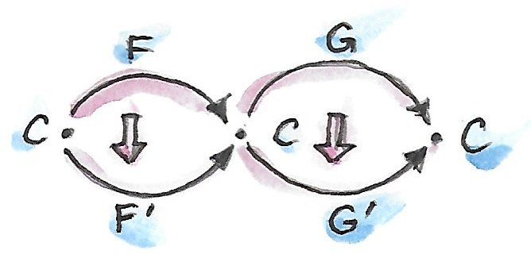
水平复合构图
Horizontal Composition
A Special Case of Horizontal Composition by Bartosz
Notes:
Whats also refers to Data.

Slide 19
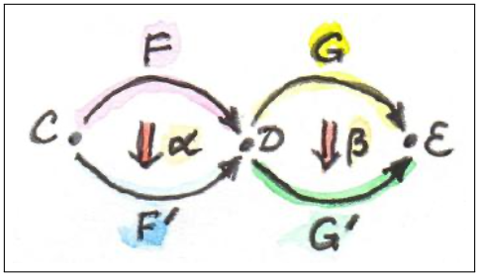
Horizontal Composition
Page. 176 of Category Theory for Programmers

Slide 20
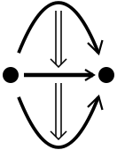
垂直复合构图
Vertical Composition
Notes:
Whats also refers to Data.

Slide 21
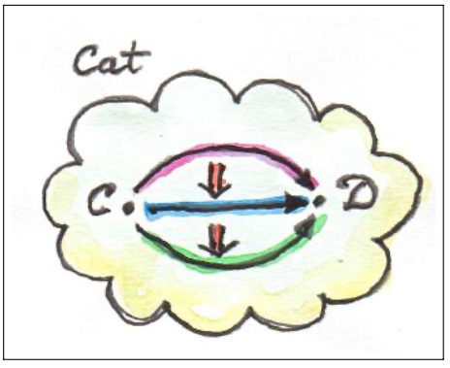
Verticle Composition
Page. 175 of Category Theory for Programmers

Slide 22
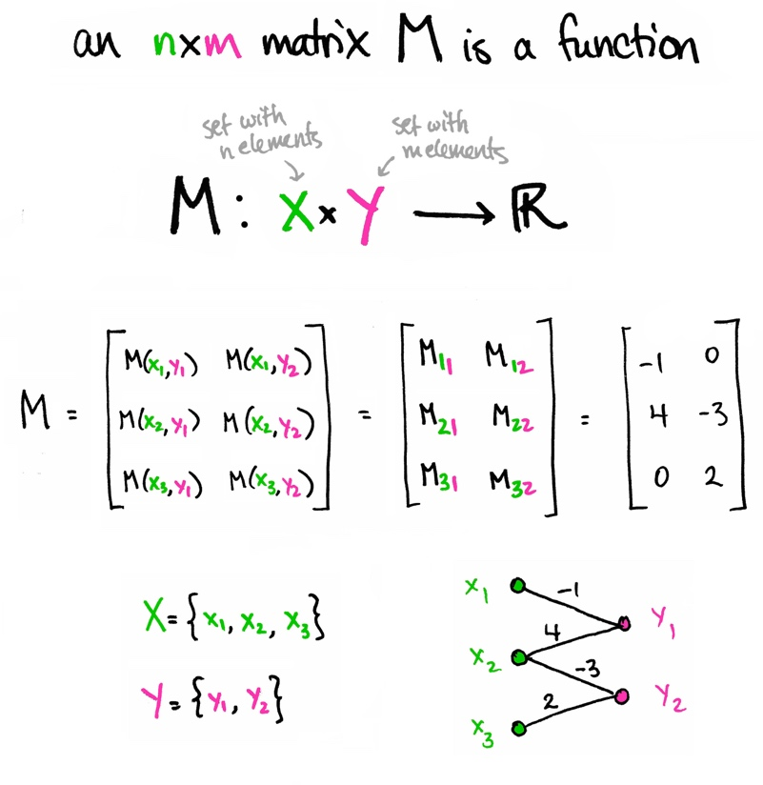
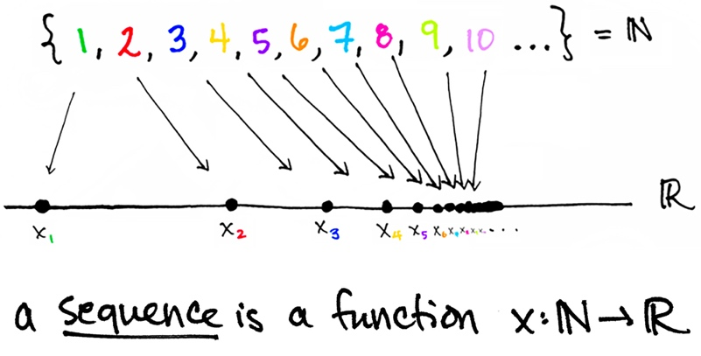

Arrow = Function = Morphism
Functors: Structure preserving morphisms (functions)
Image Source from: https://www.math3ma.com

Slide 23
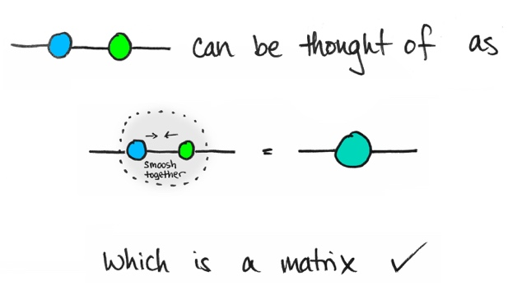
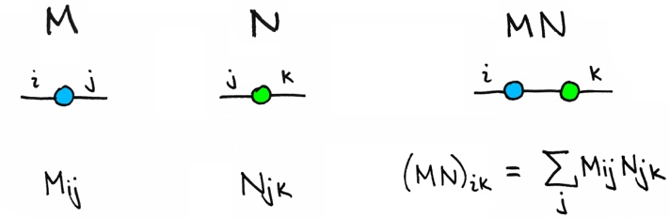
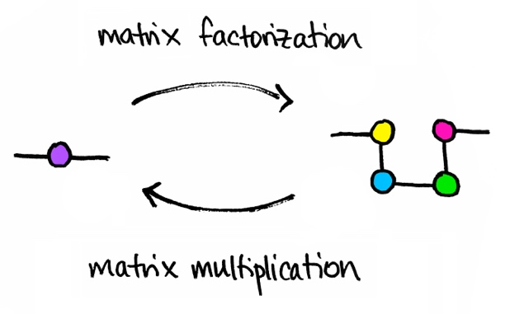
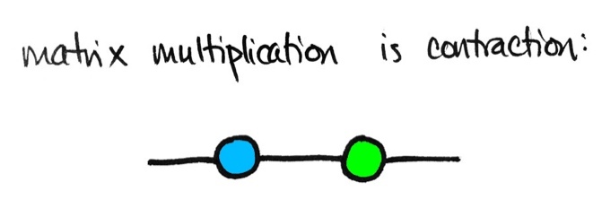
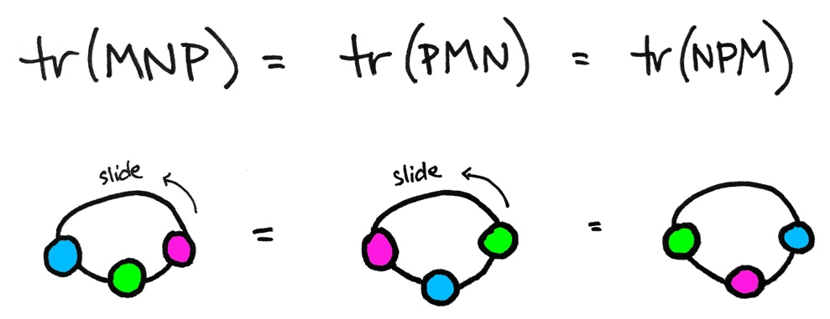
A Topological Way to Compose Matrices
Image Source: math3ma

Slide 24
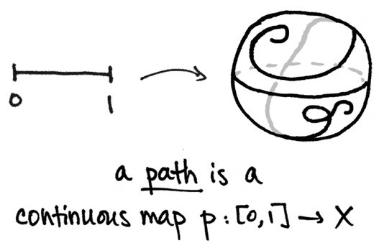
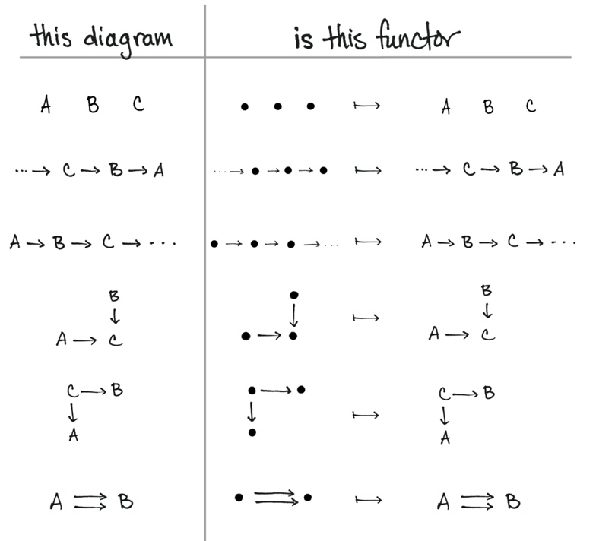
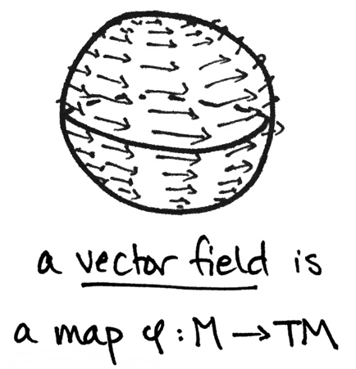
Functors are “Maps”
Functors: Structure preserving morphisms (functions)
Image Source from: https://www.math3ma.com
What is a Functor? Part I , Part II

Slide 25
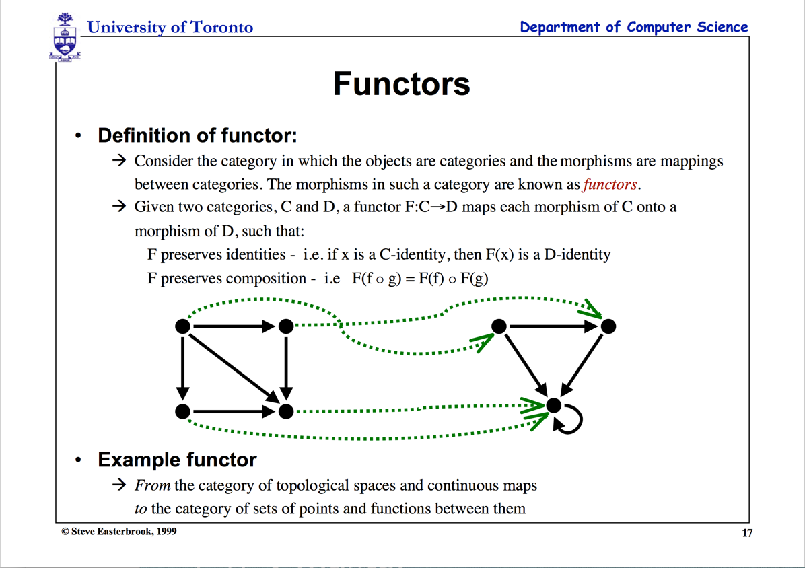

Slide 26
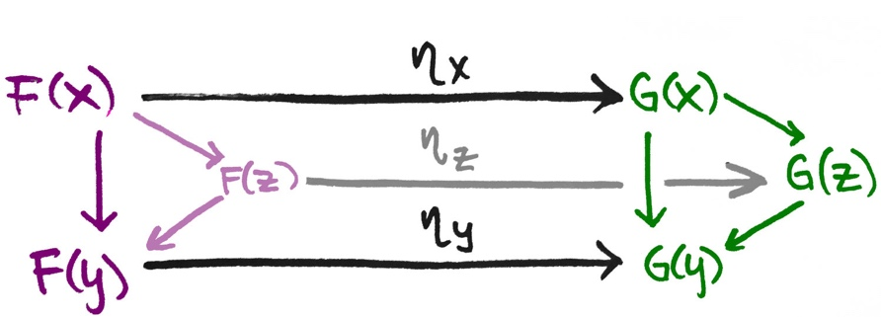
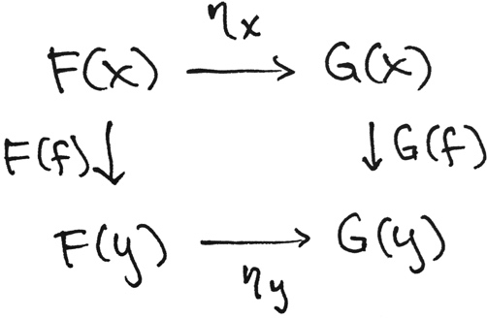
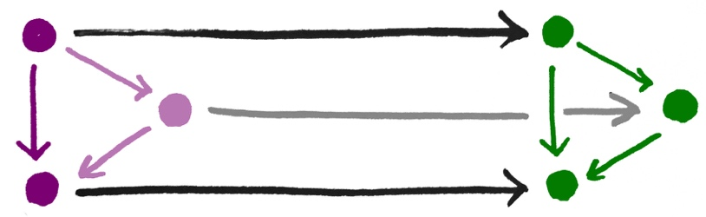

Natural Transformation “relates” Functors
Given two Functors F and G
Image Source from: https://www.math3ma.com
What is a Natural Transformation?

Slide 27
Category Theory: Unary Computation
How to do computation with only one symbol?
Verbs and Nouns are the same type!
Operators and Operands are “Terms” (Names)

Slide 28
The Categorical Lens into a Set
It is Forbidden to look into any ”object”.
All properties must be inferred from arrows!
The cardinality of a set
can only be
studied through counting arrows.

Slide 29
Glossary
Terms related to Story Telling: analogies, metaphors, symmetry-breaking
Category Theory/范畴论: A foundation of all logic and mathematics
Morphisms态射(Functions/Functors 函子/Natural Transformation自然转换): The only types of building blocks of Category Theory.
Analogies (metaphors): The fundamental building block of cognitive activities
Symmetry/Symmetry-Breaking, compression: The essence of analogies/morphisms.
Contextualization, Orientation, Measurement Units: The core elements in practical namespaces

Slide 30
科学研究的三个焦点
第一：范式所揭示的事物之本质
第二：虽普遍但较少的事实判定（边界条件）
第三：与实证数据相匹配的范式
科学革命的结构，中文翻译版 p21～p23

Slide 31
描述问题的格式，是否有一个通用的范式？

Slide 32
范式：选择问题的标准
“当范式被视为理所当然时，这些选择的问题可以被认为是有解的问题”
科学革命的结构，中译版 p38

Slide 33
规则与范式
“规则指导源于范式，但及时没有规则，范式仍能指导研究。”
科学革命的结构，中译版 p39

Slide 34
故事背景与故事板
Present a spacetime location
Present a spacetime location of event occurence
Story Boarding: (Event occurrence)
Make sure the storyline follows a consistent temporal logic
Closing the loop
Make sure that the story board resonate with the main thesis of the intentional message.

Slide 35
故事板的科学元素
The Soundness and Completeness of Story Plots
Is there a way to ensure the rigour of story construction?
The Operational Aspect of Story Telling
What are the process/tooling supports of Story Telling? (DevOps/CICD)?
The Historical Lineage of Story Telling
How to avoid name/story collision in story construction, presentation?

Slide 36
逻辑模型是否能成为描述问题的范式？

Slide 37
A Logic Model is a Function
Context: Describe the Spatial and Temporal boundaries of the project.
Abstract Specification
Goal: Mission Statement written in an imperative sentence with reference to “Context”.
Measurable Effects: Conditional statements of the observable implementation outcomes that satisfy the “Goal”.
Concrete Implementation Process
Outputs
A list of noun phrases that declares the deliverable items from proposed activities
Activities
A structured set of actions that depicts implementation activities.
Ideally written in a formalized process specification language
Inputs
Prescribe the required resources to be consumed in the implementation Process
Boundary Conditions: When and how the boundaries of the previously defined ”Context” could be broken?

Slide 38


Context: Modern Technologies challenges the cognitive capacities of human and human societies.
Goal: Provide a methodical cognitive framework to leverage contemporary technologies and cognitive science content.
Success Criteria: Enable students to utilize cognitive methods and tools, while measuring learning outcomes accordingly.
Outputs
Cognitive Science Report
Summarize your methods
Digitally published Learning Reports
Behavioral Data (on MediaWiki)
Personally chosen application areas
Biology, Physics, Math, Literature, Social Science, Arts, …
Activated Processes
1. Course Preparation
Content and Process design
2. Learning Program Execution
16 week exercise
3. Program Refinement
Continuous Adjustments
Periodic Refinements
Inputs
Curricular Structure
Coherent with university-level curriculum design
Content Data
A time-oriented knowledge(data) representation framework
Meta Data Formats
Logic Model(OKRS), Learning Report Format, Universal Resource Locators
Boundary Conditions: Personal willingness to adopt a new cognitive foundation, and intensity of practicing this new skill

Slide 39
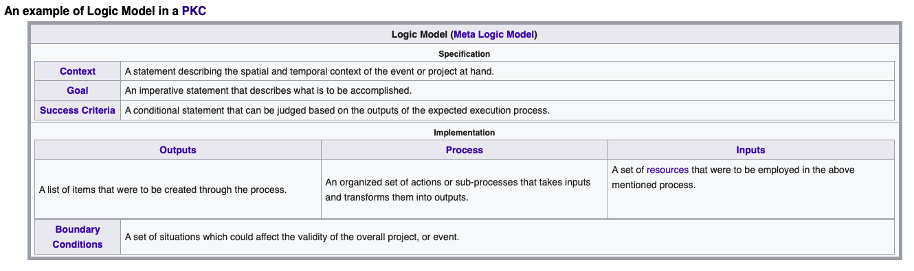
逻辑模型的Wiki Template
Notes:
Whats also refers to Data.

Slide 40
达标条件(Success Criteria)与实践手段(Implementation) 的依存关系
Notes:
Whats also refers to Data.

Slide 41
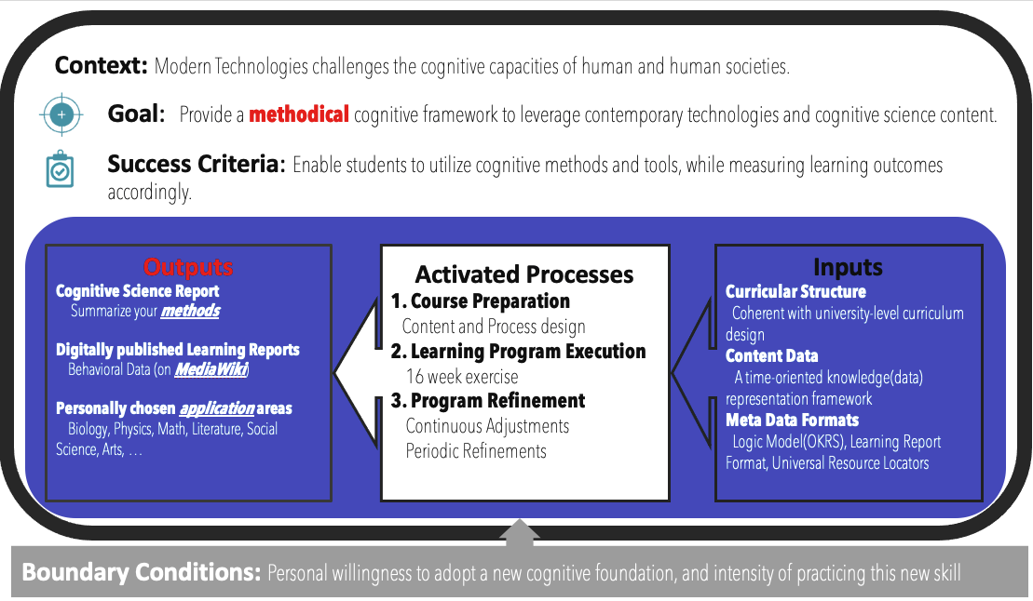
边界条件(Bounary Condition) 等同 函数的例外处理（Exception Handling)
Notes:
Whats also refers to Data.

Slide 42
Order, Proportion and Proportionality
Orders in time, in scale, and in proportions
Construct stories in abstract structures, such as Partially Ordered Sets (POS)
Organize story content in terms of temporal order, complexity scale, and relative proportions
Proportions between strategic elements in the story
Allocate the amount of resources to the story plot development in “balanced” proportions
Proportionality
Choosing a set of measurment units. (Natural Units, Metric/English Units, Computing Units)

Slide 43
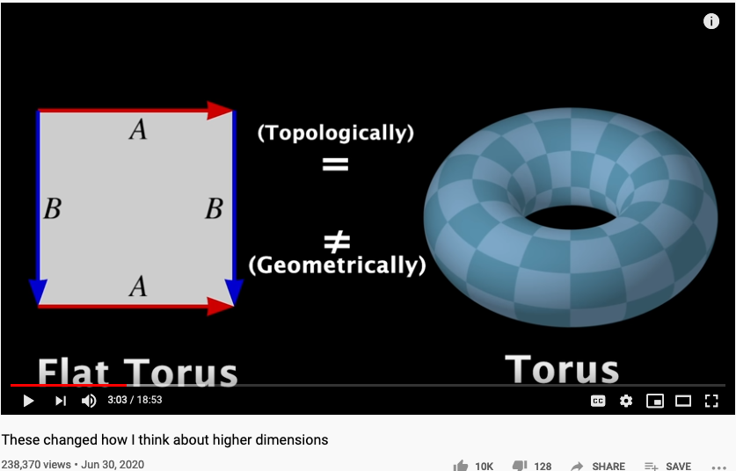
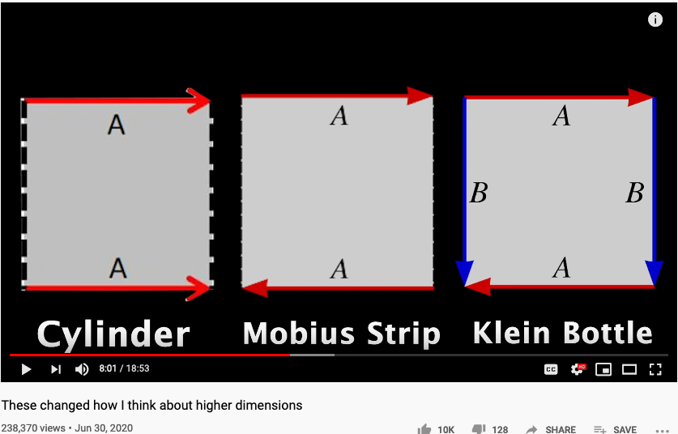
Higher Dimensional Structure denoted by Arrows
https://youtu.be/lmcT2mP2bfE?t=183
https://youtu.be/lmcT2mP2bfE?t=481

Slide 44
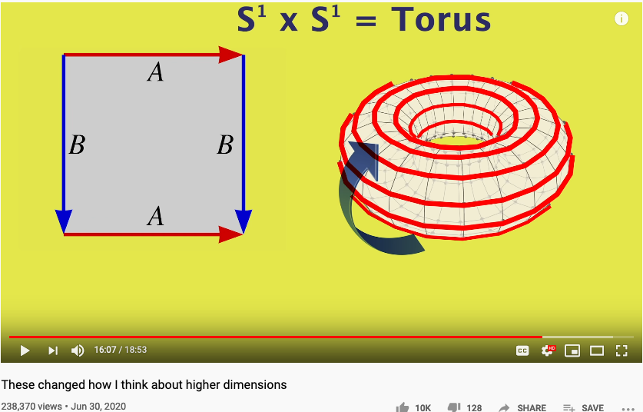
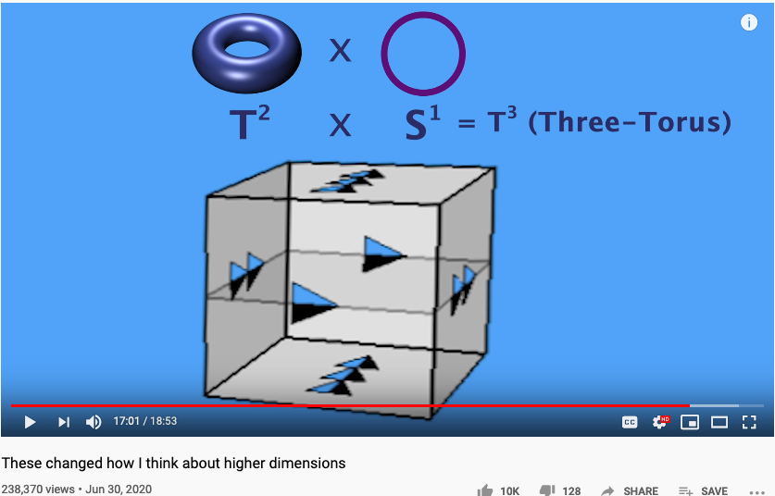
The Idea of Multiplication expressed in Arrows
https://youtu.be/lmcT2mP2bfE?t=967
https://youtu.be/lmcT2mP2bfE?t=1021

Slide 45
The World According to Category Theory
Find an image that shows arrow that
points to another arrow
A mathematical foundation based on one notation: arrow!
Also known as the arrow chasing computation.

Slide 46
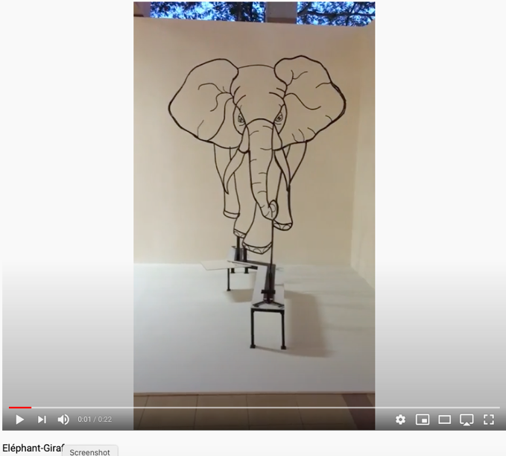
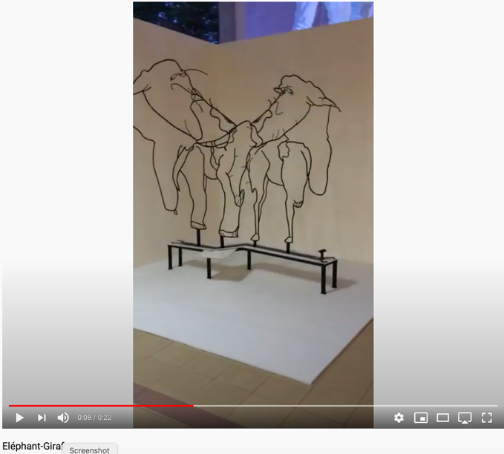
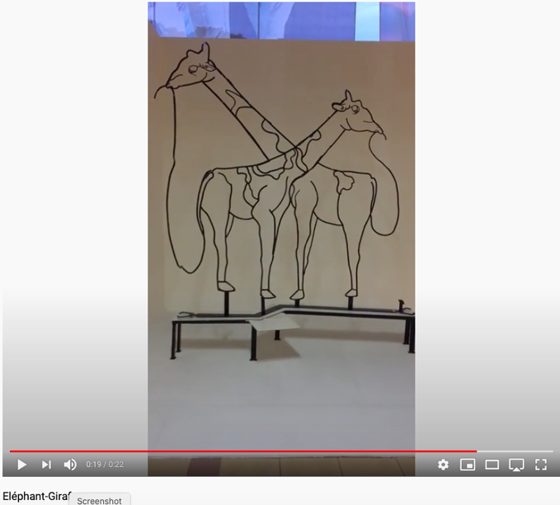
Perspectives of Category Theorists (Yoneda Perspective)
Yoneda lemma implies:
all vantage points give all information.
- excerpt from Math3ma

Slide 47
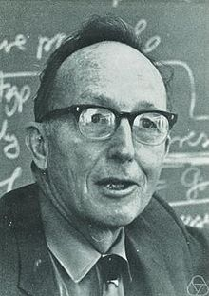
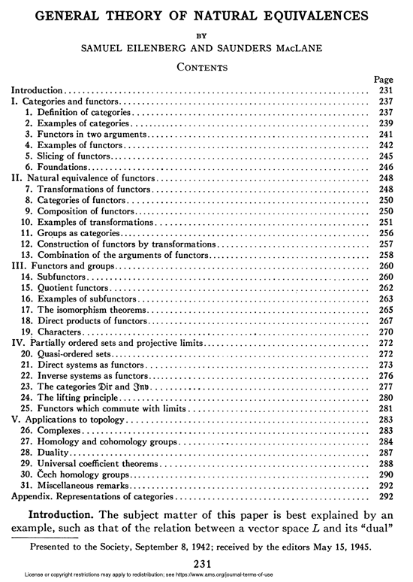
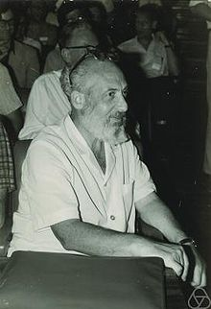
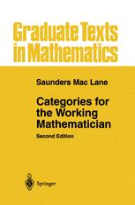

A General Theory of Natural Equivalences
Mac Lane and Eilenburg founded Category Theory with this paper.

Slide 48




Universal Constructs
The most general possible way to name things consistently!
Coq:
Interactive Proof Assistant
Based on Univalence Foundations and the Coq Proof assistant, Voevodsky created a path to organize mathematical knowledge in a computable language based on ”Higher Category Theory”, also known as Homotopy Type Theory.

Slide 49


The Story behind Univalent Foundation and its roots in Category Theory
Voevodsky in 2011
Image Source: Wikipedia

Slide 50
The Idea of Universality
“Best Approximation” possible,
up to Isomorphism
Sometimes called equivalence up to isomorphism

Slide 51
Arrows as Universal Building Blocks
If it looks like a pig, walks like a pig, and taste like a pig, it is a pig.

Slide 52

Category Theory and Type Theory

Slide 53


Universal Constructions as a “uniquing” strategy

Slide 54


Limits and Co-Limits
Image Source from: https://www.math3ma.com

Slide 55




What is Monad
A Monad is the minimal amount of structure needed to overload function composition in a way that “performs an extra computation” on the intermediate value.
- Youtuber Shelljump
An additional stage, known as Kleisli Category of computational indirection, infuses significant flexibility in function composition.

Slide 56



Kleisli Arrow of outrageous Fortune

Slide 57
Yoneda Lemma
1. Idea
The Yoneda lemma says that the set of morphisms from a representable presheaf y(c) into an arbitrary presheaf X is in natural bijection with the set X(c) assigned by X to the representing object c.
The Yoneda lemma is an elementary but deep and central result in category theory and in particular in sheaf and topos theory. It is essential background behind the central concepts of representable functors, universal constructions, and universal elements.
-excerpt from nLab

Slide 58

Category Theory is the Mathematics of networks
John Baez
Based on Marquis, Jean-Pierre on Stanford Encyclopedia of Philosophy**: “Category theory has become an important role in contemporary mathematics and theoretical computer science. It is a powerful language, or conceptual framework, allowing us to see the universal components of a family of structures of a given kind, and how structures of different kinds are interrelated”
Source: *John Baez’s Stuff, http://math.ucr.edu/home/baez/
**Jean-Pierre Marquis, https://plato.stanford.edu/archives/win2015/entries/categorytheory/
Notes:
Category theory has become an important role in contemporary mathematics and theoretical computer science.

Slide 59
范畴论: 不需要数字的计算方法（基于箭头的算术）
A Category is a diagram composed of Objects and Arrows
构成
B
f
g
h
A
C
案例: 由三个对象 (A,B,C) 和两个箭头(f, g)所构成的范畴
“Category Theory is a graph with a rule for composing arrows (f,g) head to tail to give another arrow (h)。”
M. Barr, and C. Wells, Category theory for computing science. 1990. 21.

Slide 60
Formal Definition of Category Theory
所有的范畴必须满足以下条件：
id_{B}
B
f
g
A
C
id_{A}
id_{C}
由箭头与箭头所指的对象所构成
每一个对象X 必然有一个自指的箭头 id_{X}
首尾相连接的箭头可以“构成”（compose）新的箭头

Slide 61
Category Theory is about composing Arrows
下列两个箭头( f, g ) 可被构成/聚合 (composed ) 为一个箭头 h
B
f
g
A
h
C
范畴论的符号系统是用来展现函数/函子/自然转换的可聚合性（composability）

Slide 62

Universal Morphism
The most important definition in category theory: Universal Property

Slide 63
Compute by Arrow Chasing
B
B
Always implies:
f and g can be
composed into
h
where
h = g ◦ f
f
g
f
g
A
h
C
h = g ◦ f
A
C
Functional Composition
h = g ◦ f

Slide 64
Measurement results come from:
comparison/symmetry-breaking

Slide 65


Functor in Action
https://youtu.be/XcM39gnqgNc?t=155
https://youtu.be/YLIH8TKbAh4?t=389

Slide 66



Various ways to interpret Natural Transformation
Think about Natural Transformations as various kinds of Abstract Interpretations?

Slide 67

ALL Concepts can be represented using Kan Extension
A highly useful mathematical construct for teaching and learning abstractions.

Slide 68

Multiplication

Slide 69

Addition

Slide 70





Functional Composition
Decomposition
C
C ^{OP}
3D printing
3D printing
g
F ^{op}
f
f ⁻¹
g ⁻¹
2D printing
1D movement
(Opposite Functor)
2D printing
1D movement

Slide 71









函数对等性与交换律(Commutativity)
两条首尾对象相同的路径表示:两套函数 (morphisms) 可对等交换 “commutes”
h = g ◦ f
$$\underset{→}{ f }$$
$$\underset{→}{ g }$$
The crucial aspect of a category is that
two appropriately compatible arrows can
be combined (by composition ) to form a third
arrow.
$$\underset{→}{ h }$$
$$\underset{→}{ f }$$
q ◦ k = g ◦ f
$$\underset{→}{ k }$$
$$\underset{→}{ g }$$
$$\underset{→}{ q }$$

Slide 72


Any ordered system，can be represented by Arrows

Slide 73

The Commonalities of these different characters?
Notes:
Nespresso borrowed the insights from Hp, basically “If selling replacements is succesful then we have to focus on the replacements to succeed”
Borrowing experiences across industries to overcome Industry Barriers and failing one and again with the same complex problems.

Slide 74

How to Tell a Story?
A Documentary: https://youtu.be/mGGS32kfGKk
Notes:
Whats also refers to Data.

Slide 75







Product Design by “Analogy”
C
F (Functor)
g
h
Maps similar structures across categories
h·g
F (Functor)
D
Think different, yet the same!
Notes:
Nespresso borrowed the insights from Hp, basically “If selling replacements is succesful then we have to focus on the replacements to succeed”
Borrowing experiences across industries to overcome Industry Barriers and failing one and again with the same complex problems.

Slide 76






Would simple “analogy” always work?
Development Process
g
h
C’
F
h·g
F (Functor)
αG
C’’
Category Company C
F’ (Functor)
?
?
C’’’
Notes:
Nespresso borrowed the insights from Hp, basically “If selling replacements is succesful then we have to focus on the replacements to succeed”
Borrowing experiences across industries to overcome Industry Barriers and failing one and again with the same complex problems.

Slide 77




Juicero Case
What happened?
120M USD
Doug Evans
Notes:
Initial idea:
Innovative small press could change the juicing industry.
Identify Customer Needs:
Customers need juice or a press?
Customers need fast and clean juice making
Smart phone app to monitor their diet
Target Specification:
Thousands of pounds on 200 cm² surface press
Home appliance or Businesses?
Producing a juice in <90 s
Concept Generation:
Over engineered (24 pieces for the lock door system).
Cold pressured
QR scan to apply the exact pressure.
-----------------------------------------------------------------------------------------------

Slide 78





Juicero by borrowing “Analogies”
Company
Development Process
Promotion Channel
F
h
f
αG
Natural transformation
h
G
g
i
H
Notes:
Nespresso borrowed the insights from Hp, basically “If selling replacements is succesful then we have to focus on the replacements to succeed”
Borrowing experiences across industries to overcome Industry Barriers and failing one and again with the same complex problems.

Slide 79


Juicero as a Textbook Case Study
Notes:
Nespresso borrowed the insights from Hp, basically “If selling replacements is succesful then we have to focus on the replacements to succeed”
Borrowing experiences across industries to overcome Industry Barriers and failing one and again with the same complex problems.

Slide 80

Tell a Story the Silicon Valley Style
Notes:
Nespresso borrowed the insights from Hp, basically “If selling replacements is succesful then we have to focus on the replacements to succeed”
Borrowing experiences across industries to overcome Industry Barriers and failing one and again with the same complex problems.

Slide 81
Conflicts/Branches/Intersections that don’t exist in Higher Dimensions

Slide 82


Counter Arguments in Higher Dimensions (intersection will not occur in Higher Dimensions)
https://youtu.be/lmcT2mP2bfE?t=551
https://youtu.be/lmcT2mP2bfE?t=579

Slide 83
范畴论可简化复杂的计算过程
Represents ONLY SOME possible trajectories to the moon
NKS 2004, MIT A New Kind of Language for Complex Engineering Systems
Case Study: NASA’s Apollo Program Benjamin Koo
Edward F. Crawley

Slide 84
完全没有算数逻辑的学科，不便成为科学！

Slide 85
外部因素：描述会 渗透/穿透 “运营背景” 边界的关键因素
抽象规范
运营背景：包括宏观/中观/微观时空场域的常用“标签”
目标：以在特定场域中达到欲求效果的 一个项目/函数/箭头 统一标签的别名
效果检验：为了达成目标的输出效果与输入资源的检验条件
输出结果：
可被统一的时间标签与命名空间联系的数据结果
具体实现过程
项目或函数的实现过程/算法细节
每一个实现过程与算法也可以被统一的标签来命名
输入资源：
可被统一的时间标签与命名空间联系的数据结果

Slide 86
认知技能来自隐喻
本体隐喻：脑中的概念与实体世界的联系
已熟悉的词汇 （如桌椅、门窗、飞禽走兽。。。）
空间隐喻：各物品或概念单元的时空定位关系
物件中的上下左右、事件发生的前后（偏序关系）
社会地位、亲属联系的高低大小关系
系统隐喻：整套物品（事件）的结构类似性
机器人对应与木流牛马
计算机的作业系统对应与国家的宪章

Slide 87
不论群体或是个人的“认知”都可用隐喻来解释
认知科学 | 数学（范畴论） | 社会学
本体隐喻 | 集合中的元素、特定的数值（0、1、3、e、pi、), 代数符号 （x、y、z）、 | 已知概念（数字、机构、指标、货币、。。。）
空间隐喻 | 数值之间的对应关系，（函數 Function) | 历史关系、合作关系 （产业链上下游关系），竞争关系
系统隐喻 | 不同範疇（Category）之間的結構對應关系（函子，Functor） | 知识地图、战略地图、产业或知识体系的演进过程（过程本身当作一种新旧之间的联系）

Slide 88

本体比喻 (Ontological Metaphor)
https://www.youtube.com/watch?v=acHxwB88dxk&t=99s

Slide 89

空间比喻 (Orientation Metaphor)
Audio-visual metaphors of the financial crisis: meaning making and the flow of experience
http://www.scielo.br/scielo.php?script=sci_arttext&pid=S1984-63982015000200311

Slide 90

系统比喻 （System Metaphor)
http://www.eoht.info/page/Analogy

Slide 91
Category Theory was invented to compare “Analogies”
Let’s see the example :
Functor
Category
Natural Transformation
Source : Milewski, 2015

Slide 92

Symmetries and Arrows
Image source: https://youtu.be/pt0aorJvKVg?t=53

Slide 93
隐喻的分类：本体／空间／系统 Metaphors are Symmetries in Meaning
本体隐喻：脑中的概念与实体世界的联系
已熟悉的词汇 （如桌椅、门窗、飞禽走兽。。。）
空间隐喻：各物品或概念单元的时空定位关系
物件中的上下左右、事件发生的前后（偏序关系）
社会地位、亲属联系的高低大小关系
系统隐喻：整套物品（事件）的结构类似性
机器人对应与木流牛马
计算机的作业系统对应与国家的宪章

Slide 94


管理本体隐喻：管理MediaWiki词汇

Slide 95
Mathematical Models: A Sketch for the Philosophy of Math (1981)
Saunders Mac Lane从数学文献中所总结出的各种动词片语
Counting | Arithmetic, Number Theory
Measuring （度量） | Real Numbers, Calculus, Analysis
Shaping （分辨形体） | Geometry, Topology
Forming （成形） | Symmetry, Group Theory
Estimating （估测） | Probability, Measure Theory
Moving （移动） | Mechanics, Calculus, Dynamics
Calculating （计算） | Algebra, Numerical Analysis
Proving （证明） | Logic
Puzzling （解谜、加密） | Combinatorics, Number Theory
Grouping （聚类） | Set Theory, Combinatorics
http://links.jstor.org/sici?sici=0002-9890%28198108%2F09%2988%3A7%3C462%3AMMASFT%3E2.0.CO%3B2-D
Notes:
Category theory has become an important role in contemporary mathematics and theoretical computer science.

Slide 96
Carlo Rovelli的 Ontological Map of Space-Time
Covariant Loop Quantum Gravity: An Elementary Introduction of Quantum Gravity Theory and Spinfoam Theory
by Rovelli and Vidotto

Slide 97
知识图谱：Ontological Engineering
Ontology engineering … studies the methods and
methodologies for building ontologies:
… formal representations of a set of concepts
… Core ideas and objectives of ontology engineering
are also central in conceptual modeling.
https://en.wikipedia.org/wiki/Ontology_engineering

Slide 98


可计算图：Computable Diagrams

Slide 99
词汇的比较 （Saunders Mac Lane vs. Modelica）
Counting | Arithmetic, Number Theory
Measuring （度量） | Real Numbers, Calculus, Analysis
Shaping （分辨形体） | Geometry, Topology
Forming （成形） | Symmetry, Group Theory
Estimating （估测） | Probability, Measure Theory
Moving （移动） | Mechanics, Calculus, Dynamics
Calculating （计算） | Algebra, Numerical Analysis
Proving （证明） | Logic
Puzzling （解谜、加密） | Combinatorics, Number Theory
Grouping （聚类） | Set Theory, Combinatorics

Slide 100


可计算图形语意：Computable Semantics

Slide 101

Sensor Placement and Data Collection

Slide 102
How Category Theory Simplifies Product Development
For a start-up, there are two possible outcomes which define two maneuvers, one reversible:
Succeed after a process, advance
Failed after a process, repeat, roll back [opposite from advance]
Repeat
Identify customer needs and problems
Advance
Advance (R&D)
Repeat
Roll Back
Roll Back
Repeat
Target specification and proof of concept
Roll Back
Development techniques / framework
Advance

Slide 103
How Category Theory Simplifies System Development
Can be simplified as :
A
B
Domain
Codomain
Data Gathering
Data Specifications
Identity Functor
Identity Functor
Eevery connection is reversible
Codomain
Domain
Infinite possibilities!!!
Find the viable paths to succeed!
Notes:
Identity functor

Slide 104


Slide 105


Slide 106


数学化的概念 Conceptual Mathematics
Authors:
William Lawvere
Stephen Schanuel

Slide 107

The Best One Hour Summary of Category Theory
Category Theory for Beginners (video series)
-Richard Southwell

Slide 108

The Best Summary on Type Theory
By the Discoverer of Monad Prof. Philip Wadler

Slide 109

Dependent Type Theory

Slide 110












期末报告模板
全球创新／制造战略

Slide 111


写简短的个人传记

Slide 112

可视化的内容大纲

Slide 113

调研历史背景

Slide 114

产品功能对比

Slide 115

市场分析

Slide 116

Sketch: 绘制故事板的工具

Slide 117

Sketch: 绘制故事板的工具

Slide 118

InDesign: 排版工具

Slide 119

Phabricator 出版工作流的任务分派

Slide 120

Phabricator 出版工作流的个人任务

Slide 121

Wolfram Physics and Category Theory

Slide 122

Embrace Complexity, Scale Agility
Notes:
In order to successful scale any method or practice, it has to have some basis in theory. This presentation will use insights from complex adaptive systems theory and the cognitive sciences to lay a foundation for that theory. Seeing software development as a problem of knowledge management, the theory will elaborate a understanding of applications as the emergent property of a co-evolutionary interactions between technology capability and unarticulated user requirements. Having established a basic theory a range of methods and tools will be elaborated. These include: - Narrative based approaches to requirements capture (not to be confused with Story telling or story boarding) which gather thousands of fragmented self-signified anecdotes relating to real and imagined needs within a user community and allow interpretation and integration into project planning. - Approaches to project planning and implementation that focus on the creation of self-organising teams of specialists and users to create novel approaches, supported by evidence to previously intractable problems. This is particularly relevant to the 5-10% of any major project which creates 95-90% of the grief. - The integration of tools such as blogs, wiki's etc into the development environment. Too often corporate environments over-constrain those tools into over rigid structures which destroy their utility. Conference: http://2015.agileindia.org

Slide 123




The Pursuit of a Unified Representation
Prof. Frank Wilczek of MIT, the Nobel Prize in Physics in 2004 "for the discovery of asymptotic freedom in the theory of the strong interaction."

Slide 124

Biology and Physiology

Slide 125


Industrial and World Dynamics
The World is made of three kinds of things:
Stock, Flow, and State variables parameterized in time

Slide 126
The Governing Rules of Story Telling
Generate deep and sustained reflections
The outcomes of Story Telling is determined by the Quality of Composition
Story thread convergence by adopting a unifying foundation (arrow)
Everything is done through the composition of arrows
Category Theory provides a computational framework to verify and generate compositions.
Richness of Expressiveness through NsM
Managing possible variations in a VERY LARGE POSSIBILITY SPACE using NsM (compression techniques)

Slide 127



The Rosetta Stone by John Baez
Image source: wikipedia

Slide 128
The Rosetta Stone of Scientific Disciplines
Biology | Math | Physics | Cybernetics/System Sciences
Homeostasis/DNA | Iterative/Recursive Functions | Multi-Scale Interactions | Feedback Loops
Cellular Construction/Boundary Setting | Difference/Differentiation | Observations | Data Collection
Lifespan Expansion | Integration | Spacetime Accumulation | Statistical Interpretation
Entropy Negation | Numbers/Generative Name Spaces/Algebras | “Unified” Theory | From Theory to Applications and Back

Slide 129


Differentiate by Breaking Symmetries
“THE TEN CHARACTERISTICS OF DIFFERENCE THINKERS
They practice empathy because they care enough to make an impact.
They have a clear sense of the change they want to make in the world.
They are impatient about tactics and endlessly patient about implementing their strategy.
They ask the right questions, and that means that they talk more than twice as much as they listen, because talking takes guts. Mostly, they ignore those who offer empty criticism.
They watch what people do and don’t just believe what people tell them.
They innovate and create at the edges, ignoring the market of everyone.
They make products for their customers, instead of trying to find customers for their products.
They understand that they need to give people a story to tell—a ‘you’ve gotta see this’ moment.
They work hard to change how people feel, by creating intangible value that gives them an emotional point of difference.
They understand that trust is their second-most valuable asset. The first is the willingness to be wrong for the right reason.”
Excerpt From: Bernadette Jiwa. “Difference: The one-page method for reimagining your business and reinventing your marketing.”
Notes:
Whats also refers to Data.

Slide 130


Does this Remind you of …
Notes:
Whats also refers to Data.

Slide 131



Historical Threads of Story Telling
Key Personalities (Lars Andersen)
Think Robin Hood
Technology History (Bows and Arrows)
The archer’s Paradox (science and wizardry)
Institutional/Regulatory History
Stories must evolve with societal and institutional rules
Notes:
Whats also refers to Data.

Slide 132

Representing Numbers using Arrows
Image source: https://youtu.be/KQv0lEaDGco?t=662

Slide 133


Developments since Category Theory
Prof. Hou at University of Minnesota
Prof. Licata at Wesleyan University

Slide 134



A New Math Foundation for Undergraduates
The Slide set can be downloaded here:
http://www.math.jhu.edu/~eriehl/berkeley-logic.pdf
Image source: https://youtu.be/A6hXn6QCu0k. by Emily Riehl

Slide 135


A Series of Lectures on Category Theory
The Lecture Series can be found here:
https://youtu.be/0AV7vg-16y0
Video Link: https://youtu.be/HO4Ro9ufUxs?t=3975. by Partha Pratim Ghosh

Slide 136
The Cognitive Considerations of Story Telling
Pick a Context that is most relevant to the ”thesis” or “moral” or the story
Contextualization, assess a proper boundary of space-time significantly reduce entropy(information)
Technologies can accelerate information processing
If the information channel capacity is overloaded, tech can help
Institutional/Regulatory Foundation creates a stable filter of information
The constitution and historical reputation of an organization could also be used as a agency for information processing

Slide 137
Construct Story Telling using Metaphorical Connections
 | Story Telling | Metaphors | Categorical Arrows
Dynamics | Story Plot | Types of Outlines | Natural Transformation
Compositional Laws | Morals of the Story | Existing Stories | Functor/Structure Preservation
Building Blocks (BB) | Spacetime Context and the Characters | Names of the BB | Functions/Morphisms/Objects

Slide 138
Summary
Arrow/Symmetry-breaking Symbols provide a unified notation for being cognizant of something
All types of things can be represented using Arrow
Identity object/arrow, defines an orientation
Functors preserves structures, Natural Transformation allows recursion on Arrow Types
The power of Category Theory/Arrow Chasing is in its simplicity
The conceptual barriers of using Category Theory/Arrow Chasing is also due to its simplicity
Maybe improved NsM for Category Theory/Arrow Types could help?
Terms to remember: Limits/Colimits, Monad, Yoneda Lemma, Kleisli Category, Horizontal and Vertical Compositions

